Slide 1
Replacing recursion with iteration
Adeesha Wijayasiri

Slide 2
Replacing recursion with iteration
To make our grammar LL(1), we introduced nonterminals X,Y,Z. None are needed.
SL isn’t needed, either.

Slide 3
Grammars (So FAR)
Our “model” PL grammar.
Modified, LL(1)) grammar.
S → begin SL end {begin}
→ id := E; {id}
SL → SL S {begin,id}
→ S {begin,id}
E → E+T {(,id}
→ T {(,id}
T → P*T {(,id}
→ P {(,id}
P → (E) {(}
→ id {id}
S → begin SL end {begin}
→ id := E ; {id}
SL → S Z {begin,id}
Z → S Z {begin,id}
→ {end}
E → T Y {(,id}
Y → + T Y {+}
→ {;,)}
T → P X {(,id}
X → * T {*}
→ {;,+,)}
P → (E) {(}
→ id {id}
Procedures SL, X, Y and Z can all be eliminated.

Slide 4
Replacing recursion
S → begin SL end
→ id := E ;
SL → S Z
Z → S Z
→
proc S;
case Next_Token of
T_begin : Read(T_begin);
repeat
S();
until Next_Token ∉ {T_begin,T_id};
Read(T_end);
T_id : Read(T_id);
Read (T_:=);
E();
Read (T_;);
otherwise Error;
end;
end;
Replaces call
to SL, and recursion on Z.
Regular Right-Part Grammar:
S → begin S+ end
→ id := E ;

Slide 5
Replacing recursion
proc E;
T();
while Next_Token = T_+ do
Read (T_+);
T();
od;
end;
proc T;
P();
if Next_Token = T_*
then Read (T_*); T();
end;
E → TY
Y → +TY
→
T → PX
X → *T
→
Replaces call
to Y, and recursion on Y.
Replaces call to X.
Regular Right-Part Grammar:
E → T(+T)*
T → P(*T)?

Slide 6
Replacing recursion
proc P;
case Next Token of
T_(: Read(T_();
E();
Read(T_));
T_id: Read(T_id);
otherwise Error;
end;
end;
Regular Right-Part Grammar:
S → begin S+ end
→ id := E ;
E → T(+T)*
T → P(*T)?
P → (E)
→ id
No change!

Slide 7
summary
To make our grammar LL(1), we introduced nonterminals X,Y,Z.
We just got rid of them.
Got rid of SL, too.
Resulting code is remarkably simple.

Slide 8
Bottom-up derivation tree, original grammar

Slide 9
Topics
Red: now
Possibilities:
Derivation tree or Abstract Syntax Tree.
Top-down, or Bottom-up.
For original or modified grammar !
Leading up to:
AST, bottom-up, for the original grammar (“the one”).

Slide 10
BU DT, original grammar
S → begin SL end
→ id := E ;
SL → SL S
→ S
proc S;
case Next_Token of
T_begin : Read(T_begin);
S();
Write (SL → S);
while Next_Token ∊ {T_begin,T_id} do
S();
Write (SL → SL S);
Read(T_end);
Write (S → begin SL end);
T_id : Read(T_id);
Read (T_:=);
E();
Read (T_;);
Write (S → id :=E ;);
otherwise Error;
end;
end;

Slide 11
BU DT, original grammar
proc E;
T(); Write (E → T);
while Next_Token = T_+ do
Read (T_+);
T();
Write (E → E+T);
od;
end;
proc T;
P();
if Next_Token = T_*
then Read (T_*); T();
Write (T → P*T);
else Write (T → P);
end;
E → E+T
→ T
T → P*T
→ T

Slide 12
BU DT, original grammar
We combined:
Top-down parsing
LL(1) grammar
Pre-order process
Bottom-up tree construction
Original grammar
Post-order process
proc P;
case Next Token of
T_(: Read(T_();
E();
Read(T_));
Write (P → (E));
T_id: Read(T_id);
Write (P → id);
otherwise Error;
end;
end;

Slide 13
Parser output
Input String:
begin id := (id + id) * id; end
Output:
P → id
T → P
E → T
P → id
T → P
E → E+T
P → (E)
P → id
T → P
T → P*T
E → T
S → id:=E;
SL→ S
S → begin SL end

Slide 14
summary
Red: done
Possibilities:
Derivation tree or Abstract Syntax Tree.
Top-down, or Bottom-up.
For original or modified grammar !
Clean implementation, using stack of trees.
ONE MORE THING TO DO: BUILD the AST ! (“the one”)

Slide 15
Bottom-up AST, original grammar

Slide 16
Topics
Red: now
Possibilities:
Derivation tree or Abstract Syntax Tree.
Top-down, or Bottom-up.
For original or modified grammar !
OUR FINAL GOAL ! (“the one”)
Build the AST, for the original grammar, bottom-up.
This is THE way to build a parser.

Slide 17
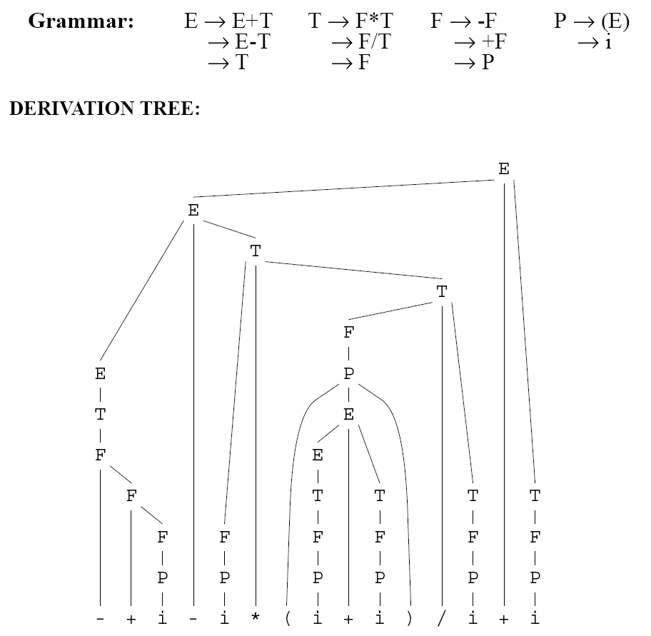
Building Derivation Trees
Sample Input : - + i - i * ( i + i ) / i + i

Slide 18
Abstract Syntax Trees
AST is a condensed version of the derivation tree.
No noise (intermediate nodes).
String-to-tree transduction grammar:
rules of the form A → ω => 's'.

Slide 19
Example
Notes:
Discussed in Lecture 04. String-to-tree transduction grammar:

Slide 20
AST, Bottom-UP, original grammar
S → begin S+ end => ‘block’
→ id := E ; => ‘assign’
proc S
int N=1;
case Next_Token of
T_begin:Read(T_begin);
S();
while Next_Token ∊ {T_begin,T_id} do
S();
N++;
Read(T_end);
Build_tree(‘block’, N);
T_id: Read(T_id);
Read (T_:=);
E();
Read (T_;);
Build_tree(‘assign’,2);
otherwise Error;
end;
end;
Build Tree (‘x’,n):
Pop n trees,
Build ‘x’ parent node,
Push new tree.
Read() no longer builds tree nodes, except for <id>, <int>, etc.

Slide 21
AST, Bottom-UP, original grammar
proc E;
T();
while Next_Token = T_+ do
Read (T_+);
T();
Build_tree(‘+’,2);
od;
end;
proc T;
P();
if Next_Token = T_*
then Read (T_*); T();
Build_tree(‘*’,,2);
end;
E → E+T => ‘+’
→ T
T → P*T => ‘*’
→ P

Slide 22
AST, Bottom-UP, original grammar
proc P;
case Next Token of
T_(: Read(T_();
E();
Read(T_));
T_id: Read(T_id);
otherwise Error;
end;
end;
P →(E)
→ id
No Build_tree() necessary

Slide 23
Parser output
Input String:
begin id₁ := (id₂ + id₃) * id₄; end
Output (Tree-building actions):
S → begin S+ end => ‘block’
→ id := E ; => ‘assign’
E → E+T => ‘+’
→ T
T → P*T => ‘*’
→ P
P →(E)
→ id
BT(id₁,0)
BT(id₂,0)
BT(id₃,0)
BT(‘+’,2)
BT(id₄,0)
BT(‘*’,2)
BT(‘assign’,2)
BT(‘block,1)

Slide 24
How to write a parser
Starting point:
A Regular Right-Part, Syntax-Directed Translation Scheme
Write parser directly from the grammar.
There’s (likely) an LL(1) grammar lurking in there, but
Don’t need to write it explicitly.
Calculate Select sets, er, well … selectively.
Don’t need Derivation Tree.
Recognize patterns, build code.
This is THE way to build a parser.

Slide 25
First-child, next-sibling trees
A binary tree, used to represent n-ary (general) trees.
Left child is first child.
Right child is next sibling.
N-ary tree:
First-child,
next-sibling tree:

Slide 26
Advantage of first-child, next-sibling trees
Pre-order traversal is the same.
Useful to print a tree, in indented format.
a(3)
... b(0)
... c(3)
...... e(0)
...... f(0)
...... g(0)
... d(0)

Slide 27
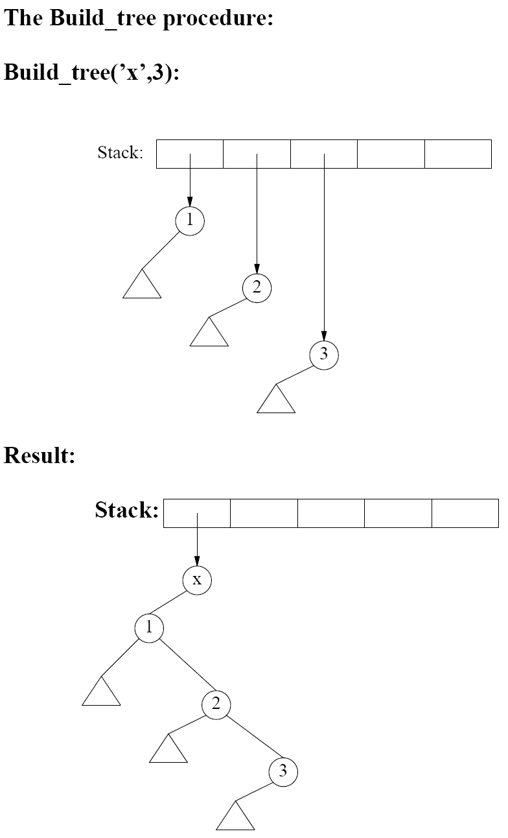
The build_tree procedure
proc Build_tree(x,n);
p=nil;
for i=1 to n do
c=pop(S);
c.right=p;
p=c;
end;
Push(S,node(x,p,nil));
end;
Build_tree(‘x’,3):
Result:
works with n=0, too.

Slide 28
summary
Red: done
Possibilities:
Derivation tree or Abstract Syntax Tree.
Top-down, or Bottom-up.
For original or modified grammar !
OUR FINAL GOAL ! (“the one”)
Build the AST, for the original grammar, bottom-up.
This is THE way to build a parser by hand.

Slide 29
Acknowledgements
Programming Language Pragmatics by Michael L. Scott. 3rd edition. Morgan Kaufmann Publishers. (April 2009).
Lecture Slides of Dr.Malaka Walpola and Dr.Bermudez

